Slide 1

Microsoft Office
Prepared by:
Alan Najat
Dana Zeadin
Abdulmuamin
Abdulrahman
Mohammed
Supervised by:
Sozan Zaher
Salahadin University
Coleg of since

Slide 2
outline
Microsoft Word
Microsoft Powerpoint
Microsoft Excel
Microsoft Access

Slide 3
Introduction
Microsoft Office is an office suite of desktop applications, servers and services fot the Microsoft Windows and Mac OS X operating systems, introduced by Microsoft on August 1, 1989.
First version of office contined Microsoft word,Microsoft Excel and Microsoft power point. Over the years office applications have grown substantially closer shared features such as a common spell checker

Slide 4
What is Microsoft Office?
Microsoft office can be seen as a form of a collection of an array of office-related application. Each of these Office-related applications has been created by the team of developers at Microsoft to cater to different uses. Microsoft in 2019 launched the latest version of its cloud-based computing platform of MS Office called Microsoft 365.

Slide 5
History of MS Office
The history of MS Office starts officually from NOVEMBER 19,1990, when Office for windows (also called MS Office 1.0) came out for use with Windows 2.0. before Office 1.o, the basic elements of the package were still available as separate programs but for MS-DOS. With the publication of the first version of only three programs word, power point, excel created by c++(back-end)

Slide 6
Microsoft Office

Slide 7
Programs of MS Office
MS word: is a word processor that lets users make and edit text documents, such as reports, letters and resumes and run spell-checks on writing.
MS power point: allows you to visually display information, using anything from basic slideshows to professional multimedia presentations.
MS Access: is a database management system that allows you to link and use data from other sources, manipulate the data you have gathered in different ways, as well as create simple business applications.
MS Excel: is an electronic spreadsheet program that helps you store, organize and manipulate data by creating simple to complex spreadsheets.
MS publisher: is graphic design app that gives users creating material for marketing or publications more options in the layout and design of their document
MS OneNote: is a digital alternative to a paper notebook that allows you to create, organize and share your notes easily.
MS outlook:is a personal information manager mainly used for emails but that can also be used to store calendars and contact information, manage tasks as well organize meeting

Slide 8
What are the advantages and disadvantages of MS Office 365
ADVANTAGES
Cost effective
Storage drive
Easy access to files
Email is accessible and affordable
Scalility
Additional tools
DISADVANTAGES
Cost considerations
Infrastructure confinguration
Data security
Email quotas and limitations

Slide 9
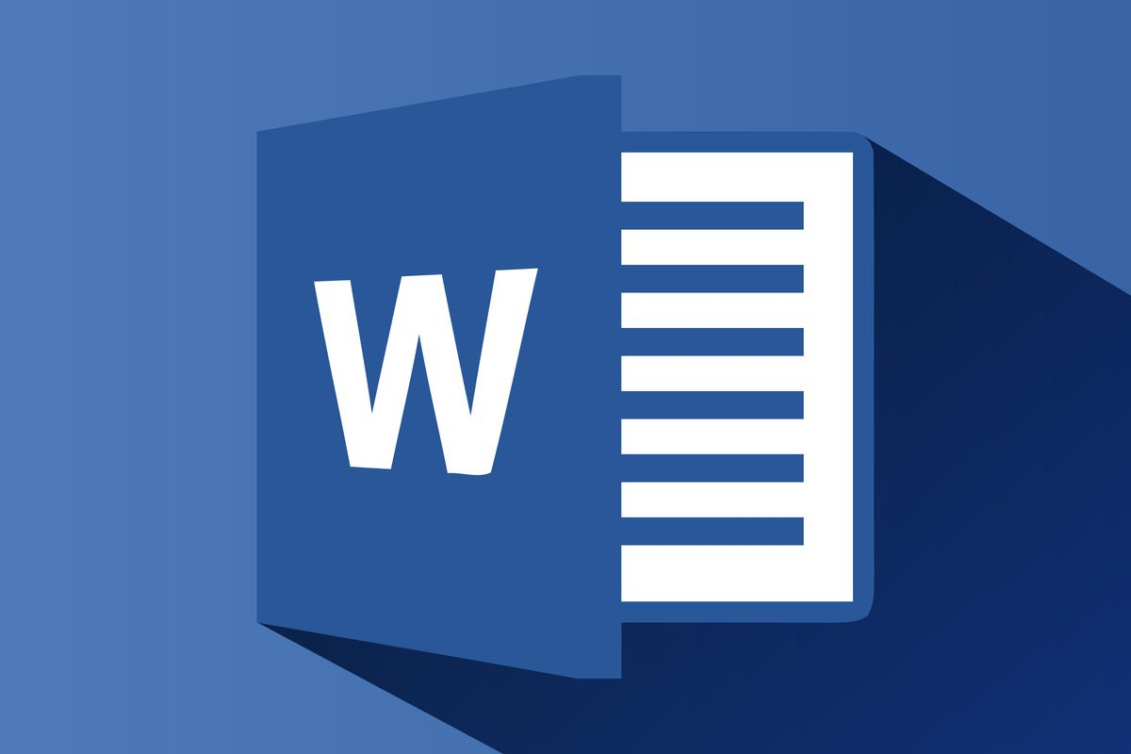
Microsoft Word

Slide 10
Introduction of microsoft word
Microsoft word is a word processor software developed by Microsoft in 1983. It is the most commonly used word processor software. It is used to create professional quality documents, letters, reports, resumes, etc and also allows you to edit or modify your new or existing document. The file saved in Ms Word has .docx extension. It is a component of the Microsoft Office suite, but you can buy it separately and is available for both Windows and macOS. The latest version of Ms Word is 2019. In this article we will learn the features of Ms Word, but first we learn how to open Ms Word?

Slide 11
What is microsoft word
You may be wondering: what type of program is Microsoft Word? A good definition is that it's a word processor. That's an application you use to “process”— format, manipulate, save, print, share — a text-based document.
Microsoft Word is arguably the most popular word processor on the planet. That’s because it’s part of Microsoft’s Office Suite, which is installed in 1 billion devices in the world (according to groovyPost).

Slide 12
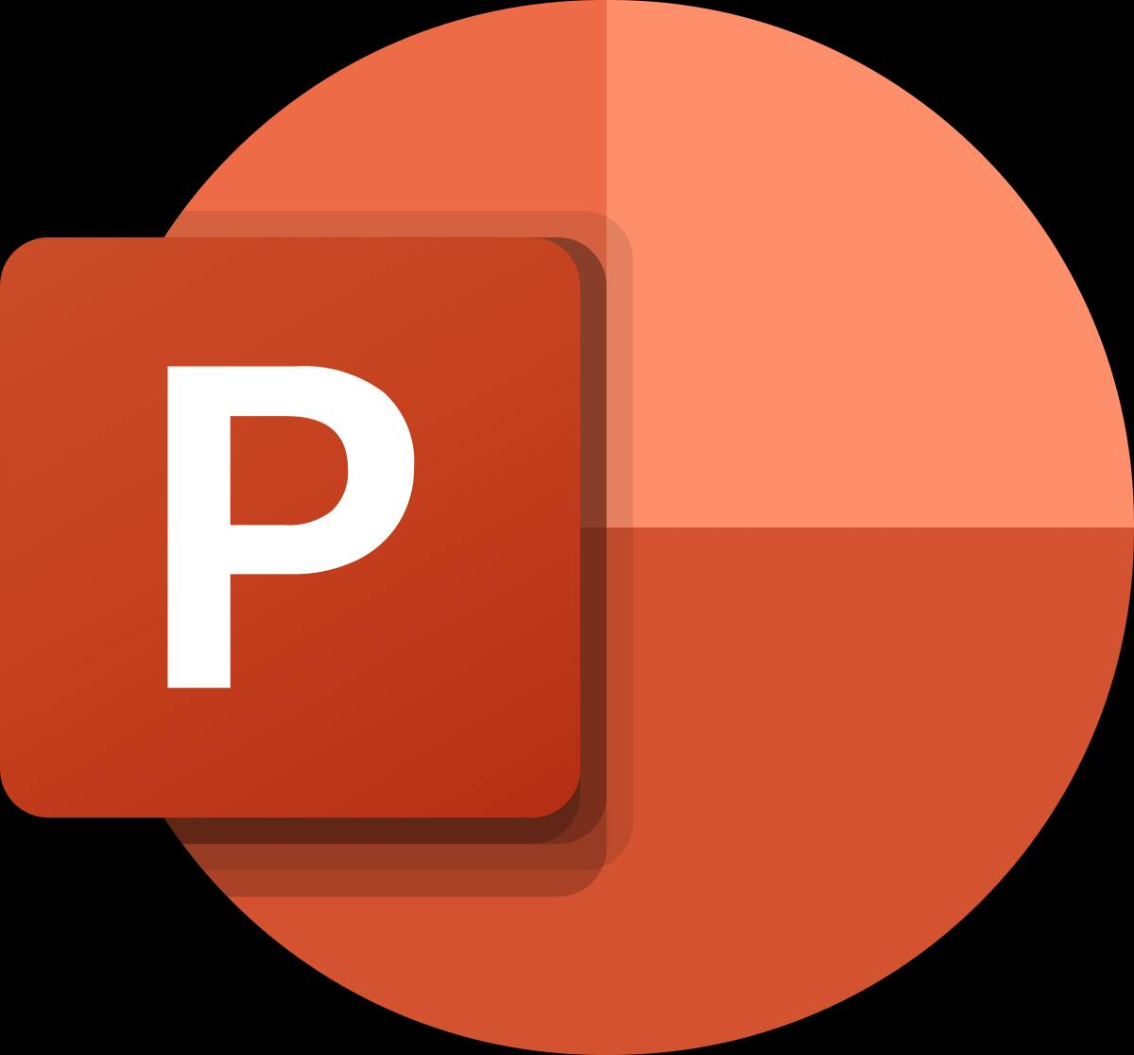
Powerpoint

Slide 13
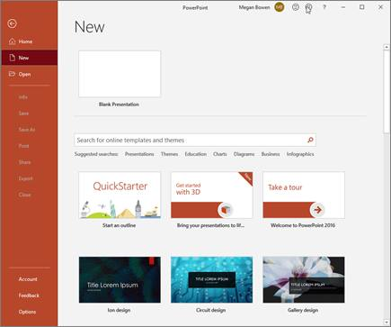
Create a new presentation
1. Open PowerPoint.
2. Select Blank presentation, or select one of the themes.
3. Select More themes to view the gallery and search for more.

Slide 14
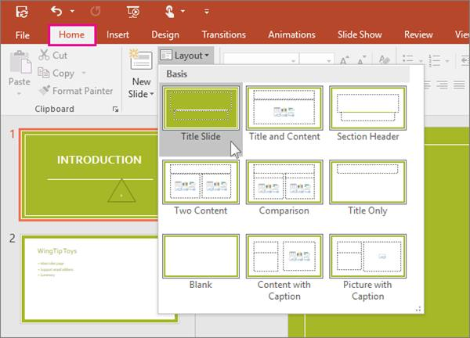
Add a slide
1. Select the slide you want your new slide to follow.
2. Select Home > New Slide.
3. Select Layout and the you type want from the drop-

Slide 15
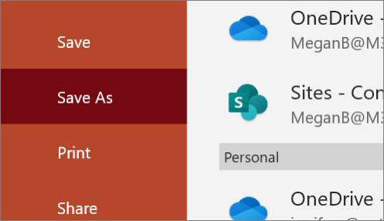
save
When you save your files to the cloud, you can share and collaborate with others.
1. Select File > Save As.
2. Select a OneDrive folder and name the file.
After you save once to OneDrive, AutoSave is enabled that saves your file automatically, every few seconds, as you work.

Slide 16
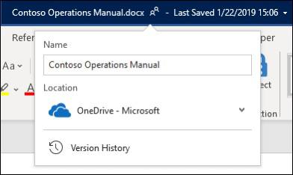
Rename a presentation
1. Select the file name on the title bar.
3. In the menu that appears you can rename the file, select a new location to move it to, or see the version history for the file.

Slide 17
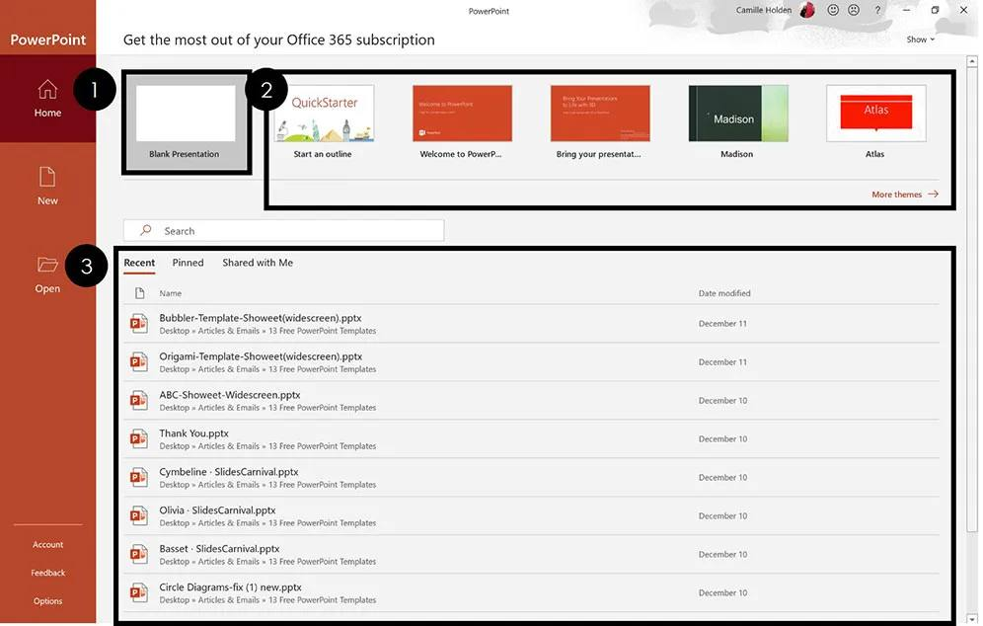
How to Make a PowerPoint Presentation (Step-by-Step)
1. Start a blank presentation.
2. Type text into your title slide.
3. Insert more slides.
4. Add content to slides.
5. Change the design.
6. Add animations & transitions (optional)
7. Save your PowerPoint presentation.
8. Print your presentation.

Slide 18

Uses of PowerPoint Presentation
• Education –PowerPoint presentations can help in making education more interactive and attract students towards the modified version of studying

Slide 19

• Marketing – In the field of marketing, PowerPoint presentations can be extremely important. Using graphs and charts, numbers can be shown more evidently and clearly which may be ignored by the viewer if being read

Slide 20

• Business – To invite investors or to show the increase or decrease in profits, MS PowerPoint can be used

Slide 21

• Creating Resumes – Digital resumes can be formed using MS PowerPoint. Different patterns, photograph, etc. can be added to the resume

Slide 22

• Depicting Growth – Since both graphics and text can be added in a presentation, depicting the growth of a company, business, student’s marks, etc. is easier using PPT.

Slide 23

Advantages of PowerPoint
It can be used virtually anywhere
Put your presentation on a USB flash drive or in any cloud storage apps and you will have your PowerPoint presentation at hand anytime. It is also included in standard professional settings, so with your user license you can access your presentation from anywhere.

Slide 24

Disadvantages of PowerPoint
It can be used virtually anywhere
Put your presentation on a USB flash drive or in any cloud storage apps and you will have your PowerPoint presentation at hand anytime. It is also included in standard professional settings, so with your user license you can access your presentation from anywhere.

Slide 25
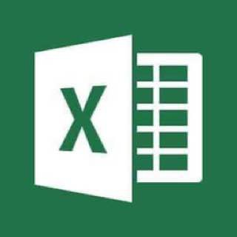
What is Microsoft Excel?
MS Excel or Microsoft Excel is a spreadsheet application developed by Microsoft in 1985. In this application, the data is organized in the form of rows and columns

Slide 26
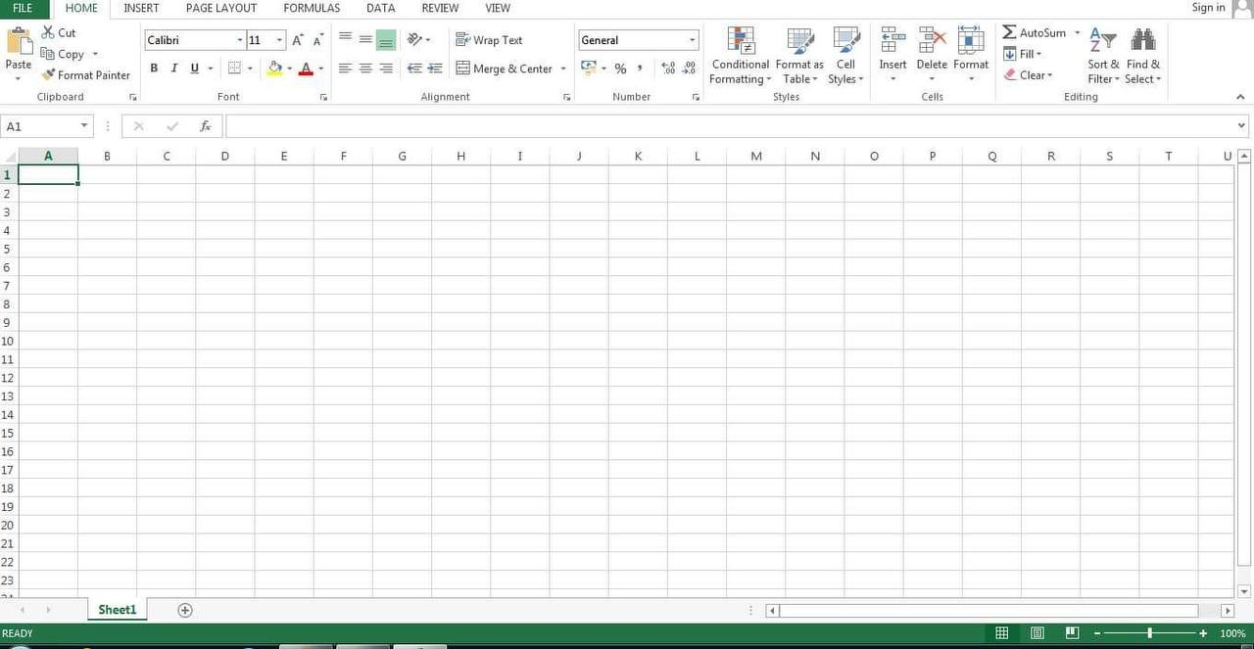
How to open MS Excel ?
To open MS Excel on your computer follow the steps given below:
• click on start
• then all program
• next step is to click on MS Office
• then finally, choose the MS Excel option

Slide 27
* The history of microsoft excel
Microsoft Excel has been around since 1982, first introduced as Multiplan, a very popular CP/M (Control Program for Microcomputers), but lost popularity on MS-DOS systems to Lotus 1-2-3. In 1987, Microsoft introduced Excel v2.0 for Windows and by 1988 began to outsell Lotus 1-2-3 and the emerging QuatroPro.
* present day microsoft excel
Flash forward to present day with the latest release of Excel 2019 and Excel365, Microsoft Excel is the most familiar, flexible, and widely used business application in the world due to its capability to adapt to almost any business process. Coupled with the use of other Microsoft Office applications, Word, Outlook, PowerPoint, etc., there is little that cannot be handled by this very powerful combination.
* the future of microsoft excel
Where do we go from here? With the internet central to our lives and business, it makes sense that the needs of the many will prevail. As the Microsoft platforms continue to evolve, it becomes a full time job to stay up-to-date on the emerging technologies. Microsoft Excel will keep it’s position as the top platform to analyze data, create charts and presentations, and integrate with powerful tools for visual dashboards and BI workflows.

Slide 28
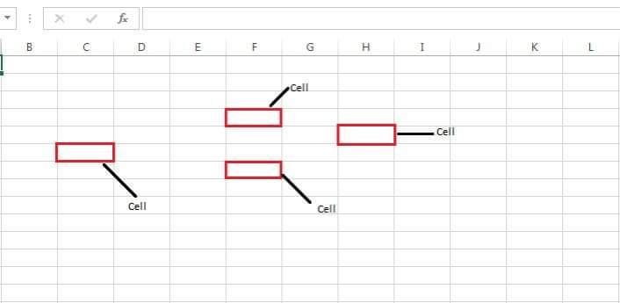
What is a cell ?
A spreadsheet is in the form of a table comprising rows and columns. The rectangular box at the intersection point between rows and columns forms a cell.
What is cell address ?
The cell address is the name by which is cell can be addressed. For example, if row 7 is interested in column G, then the cell address is G7.

Slide 29
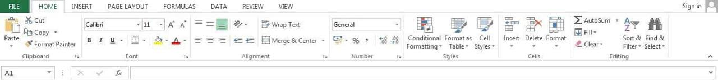
Features of Microsoft excel
• Home
• Insert
• Page Layout
• Formulas
• Data
• Review
• View

Slide 30
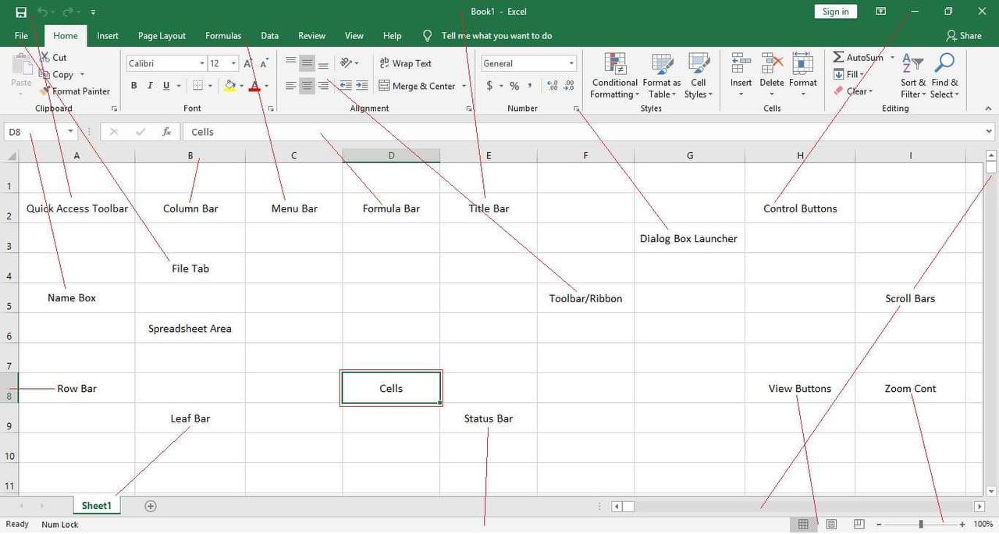
Basic Parts of Microsoft Excel Window:
Quick Access Toolbar
File Tab
Title Bar
Control Buttons
Menu Bar
Ribbon/Toolbar
Dialog Box Launcher
Name Box
Formula Bar
Scroll Bars
Spreadsheet Area
Leaf Bar
Column Bar
Row Bar
Cells
Status Bar
View Buttons
Zoom Control

Slide 31
Some functions of MS Excel
• Average
• Count
• Pi
• Sum
• Product
• Max
• If

Slide 32
What are advantages and disadvantages of Microsoft Excel ?
Advantages of Microsoft excel
* Table
* Office work
* Password protect
* A lot of data
* Use anywhere
* Sharing
* Free templates
* Multiple spreadsheets
Disadvantages of Microsoft excel
* Virus attack
* Difficult to learn
* High price
* Handing errors
* Becomes slow

Slide 33

Microsoft Access
Why is it used?
Who is using it?
Why we use it?

Slide 34
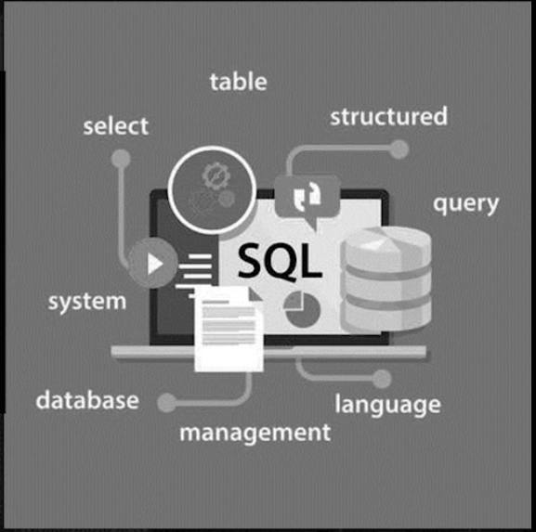
Data Base
What is it?
In computing, a database is an organized collection of data stored and accessed electronically. Small databases can be stored on a file system, while large databases are hosted on computer clusters or cloud storage

Slide 35
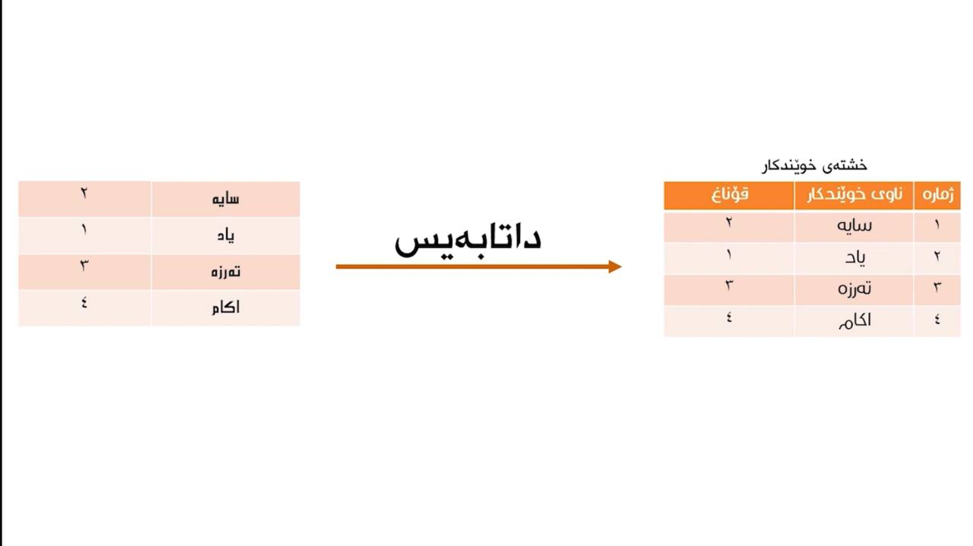
Example of Data Base

Slide 36
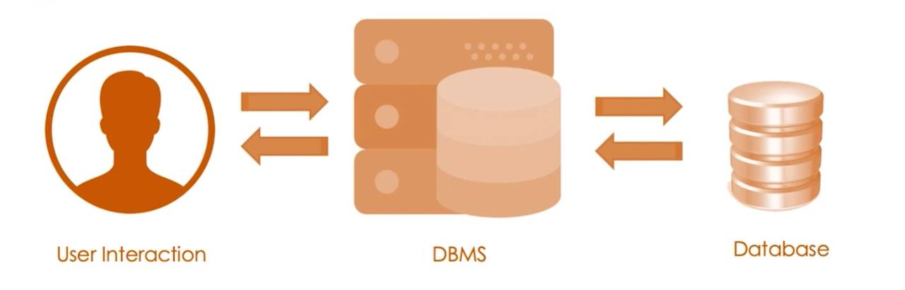
A database management system (or DBMS) is essentially nothing more than a computerized data-keeping system. Users of the system are given facilities to perform several kinds of operations on such a system for either manipulation of the data in the database or the management of the database structure itself

Slide 37
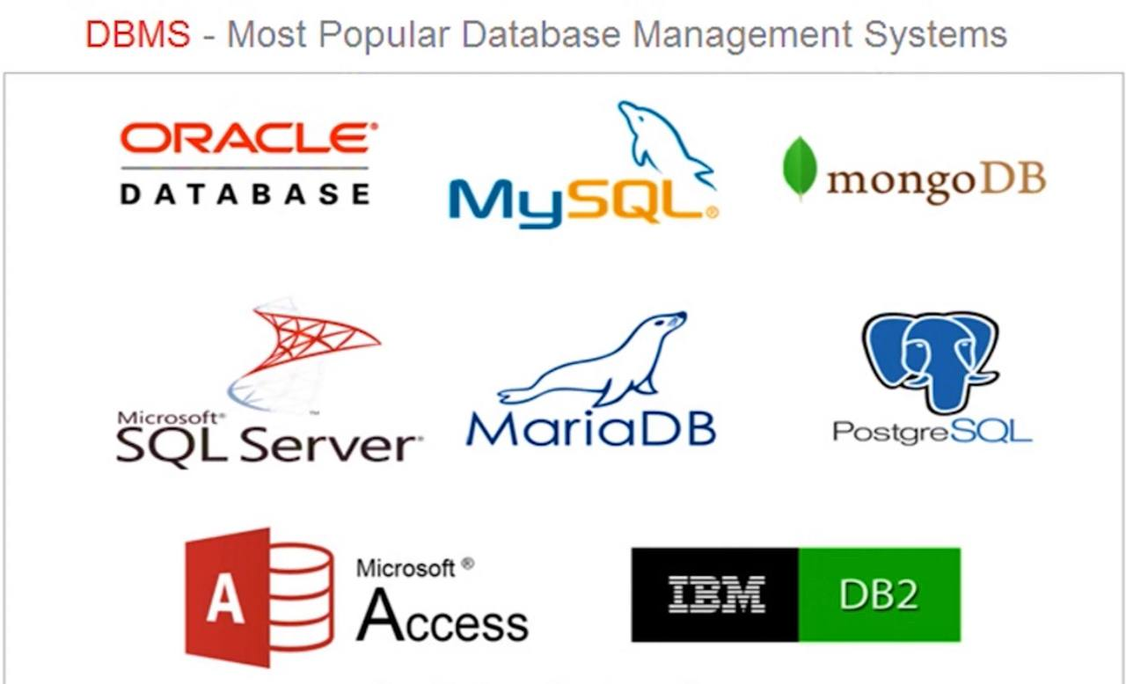

Slide 38
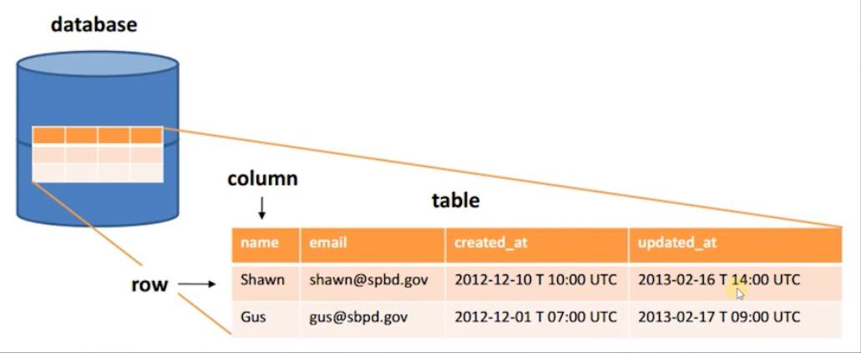
Data Base contains one more tables

Slide 39
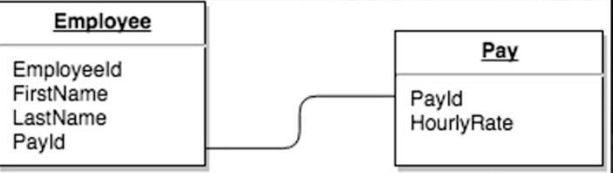
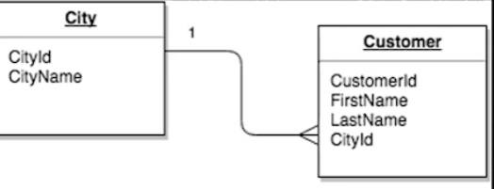
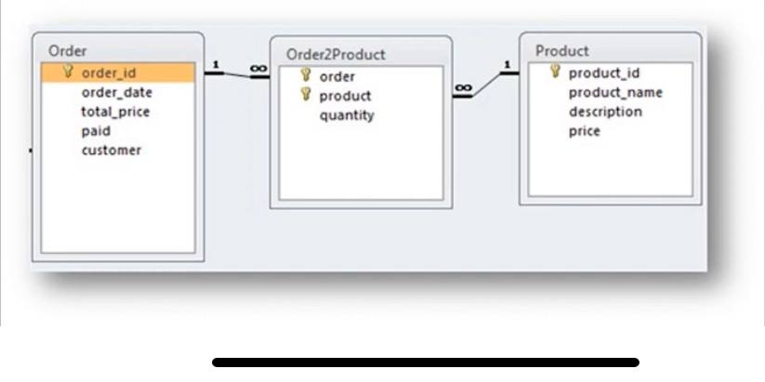
Tables and Relationship

Slide 40
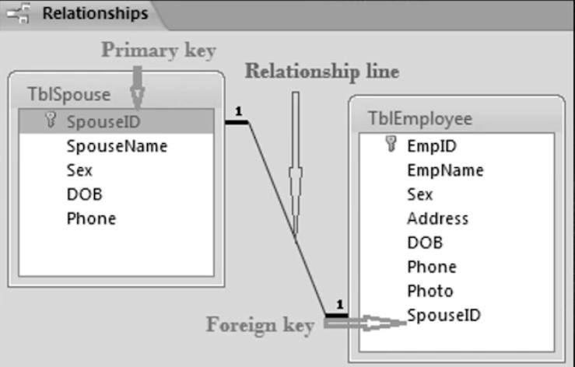
Types of (key)
Primary key
Foreign key

Slide 41
https://www.google.com/amp/s/www.excelhelp.com/the-history-of-microsoft-excel/%3Famp
https://www.google.com/url?sa=t&source=web&rct=j&url=https://subjectguides.york.ac.uk/it-essentials/office&ved=2ahUKEwjp67DroaD2AhU5SfEDHeNtBbEQFnoECD8QBQ&usg=AOvVaw2ydRt_bPLbp_a29S6gMqiT
https://synergetics1.wordpress.com/2016/12/08/what-are-the-advantages-and-disadvantages-of-microsoft-office-365/
https://www.ibm.com/docs/en/zos-basic-skills?topic=zos-what-is-database-management-system
https://byjus.com/govt-exams/ms-excel-basics/
https://synergetics1.wordpress.com/2016/12/08/what-are-the-advantages-and-disadvantages-of-microsoft-office-365/
https://www.google.com/amp/s/www.excelhelp.com/the-history-of-microsoft-excel/%3Famp

